Slide 1
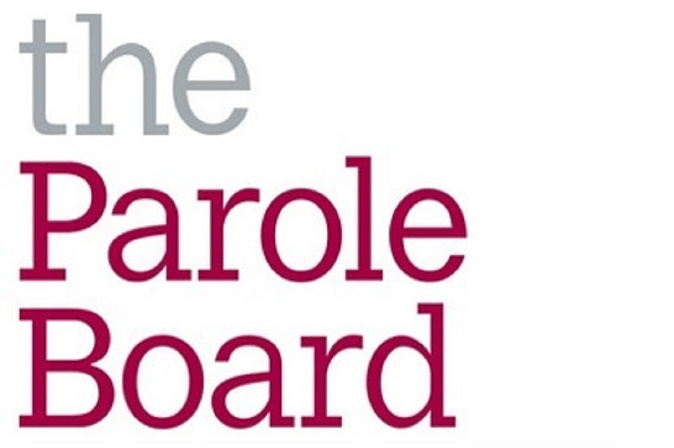
A Parole Board for tomorrow: how further reform could improve the parole system
Faith Geary, Chief Operating Officer Parole Board

Slide 2
A story of the effectiveness and dedication of the Parole Board…….

Slide 3
Reviews of the Parole Board are not new, but a review of the Parole System is.

Slide 4
Further Reform
The Parole Board as a modern court
Even greater transparency
Radical rethink of recalls across the system
Safe progress for the remaining IPP prisoners
Risk assessment in terrorist cases

Slide 5
Thank You

