Slide 1
Public Safety – what can help?
Dr Jo Bailey
8th December 2020

Slide 2
Risk Approaches
Risk Formulation: integrating and organising separate risk factors into a meaningful framework that explains a person’s offending. It provides the information base for risk management.
Risk Management: Aims to minimise the likelihood of adverse events, to achieve the best possible outcome, and deliver safe, appropriate, effective care.
View risk as an ongoing, changing entity, rather than one in which one-time, yes/no predictions would be appropriate

Slide 3
Risk Assessment
Static vs Dynamic
Development in Approach
Static factors generally don’t change over time.
Dynamic variables are amenable to change.
The earlier prediction-focused approach was mainly based on research linked to static factors.
Dynamic variables are of particular interest when looking at risk reduction.
1st Generation – unstructured clinical judgement
2nd Generation – actuarial / static assessments
3rd Generation – structured professional judgement (SPJ); e.g. SARA, HCR-20^{V2}
4th Generation – structured professional judgement with a greater focus on risk management and future planning; e.g. RSVP, HCR-20^{V3}
Risk assessment is not infallible

Slide 4
Desistance
Risk Need Responsivity
(RNR)
Different lens for the same issue?
Positive Psychology
Good Lives Model (GLM)

Slide 5
Some approaches which may be intuitive, but don’t seem to work as approaches to reducing reoffending
Punishment – services or interventions based on punishment, have the notion that people will avoid committing crimes if they understand the negative consequences of offending, or to avoid increasingly onerous punishment have been shown repeatedly to fail to reduce reoffending
Simply facilitating access to employment etc without building the skills
Deterrence – scared straight approaches which aim to deter by showing people what will happen to them don’t work and in some cases increase likelihood
Discipline – teaching discipline through military style bootcamps without other strengths approaches does not work
Insight oriented – focus on increasing insight/awareness such as victim awareness do not have an impact

Slide 6
Why don’t they work?
Develop only extrinsic motivation
Fail to build any skills
Reinforce a criminal identity
Fail to target factors associated with reoffending
Poor implementation

Slide 7
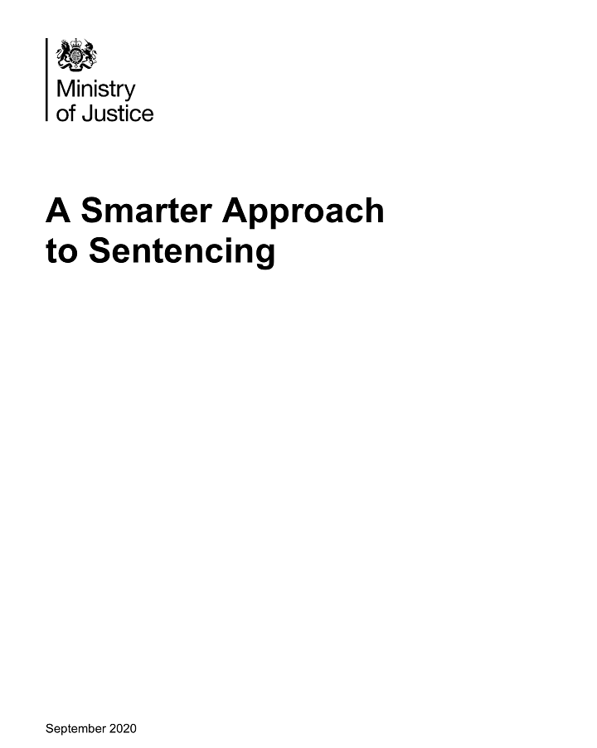
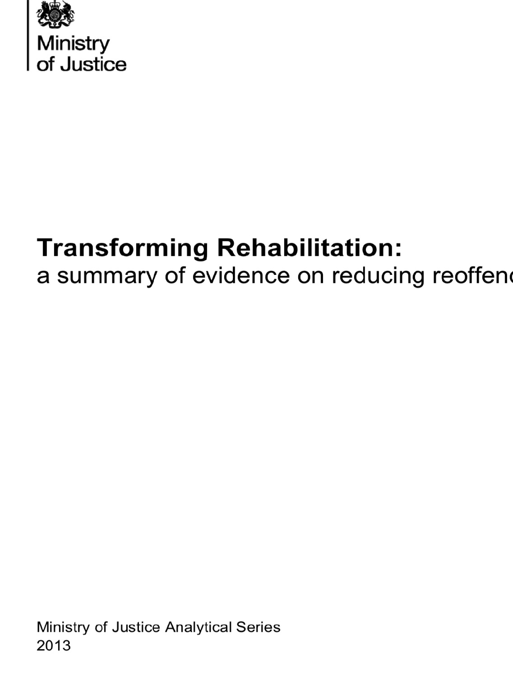
7 Pathways:
Accommodation
Education Training and Employment
Health
Drugs & Alcohol
Finance
Children and Families
Attitudes Thinking and Behaviour

Slide 8
Limited experience of work
Employment
Convictions a barrier
Moderate evidence; promising approaches include:
Unable to find employment, unemployed, poor performance or low satisfaction at work; lack of work related skills, poor attitude to employment, lack of qualifications.
Increased employability in the form of skills and motivation to work and confidence to relate constructively to others in the work setting. Steady employment particularly if it offers a sense of achievement or satisfaction
Unable to deal with stress and challenges of work
Unstable or poor quality work
Literacy, numeracy and life skills (where needed)
Employment-focused programmes that lead to real jobs
Gaining work related qualifications, gaining employability skills including problem solving and self-management
Work-related mentoring
If you have a job on release you are less likely to reoffend (by 5-9 percentage points)
Vocational/education/work training in prison can have a significant impact on reoffending
For women, unemployment is one of the areas most predictive of reoffending
It matters that employment is appropriate and meaningful and it gives you a sense of achievement
Your attitudes toward employment (such as a willingness to take a poorly paid job and use this as a stepping stone) makes a difference
Stability of employment is also important

Slide 9
In emergency hostel
Accommodation
Squatting
Sleeping rough
No fixed abode, transient, or returning to a criminogenic neighbourhood
Finding and keeping suitable housing
In B&B
Unsafe
Living in intolerable physical conditions
Limited evidence but promising approaches may be:
You are more likely to be homeless if you are in prison
Accommodation problems are worse if you have a drug/alcohol problem
And worse if you’ve been sentenced before
The first 6 months out are particularly important for long term housing
Reoffending
You are more likely to reoffend if homeless before custody
And if you need help with accommodation on release
‘Half-way houses’ may reduce reoffending but not if they reinforce criminal identities
Approaches that aim to achieve long term housing solutions, rather than temporary or crisis solutions
Services which also address the causes of homelessness such as poor mental health, substance misuse, and lack of employment
Intensive case management help to secure accommodation or linking people to existing housing services

Slide 10
Programmes and interventions that help develop pro-social
Attitudes, Thinking, Behaviour and Relationships
These factors have been found to increase programme effectiveness
Clear model of change
Use trained staff and ensure quality of delivery
Focus on factors that predict reoffending
Target medium or high risk offenders
Continuous evaluation to learn and improve
Teach multiple skills especially social skills
Motivate, engage and retain participants
Programmes and interventions…
Provide sentencing options in the community and rehabilitative opportunities in prison.
Address four of the most predictive criminogenic needs:
1. Impulsivity and low self control
2. Attitudes that support crime
3. Social networks involved in crime
4. Poor family/marital relationships

Slide 11
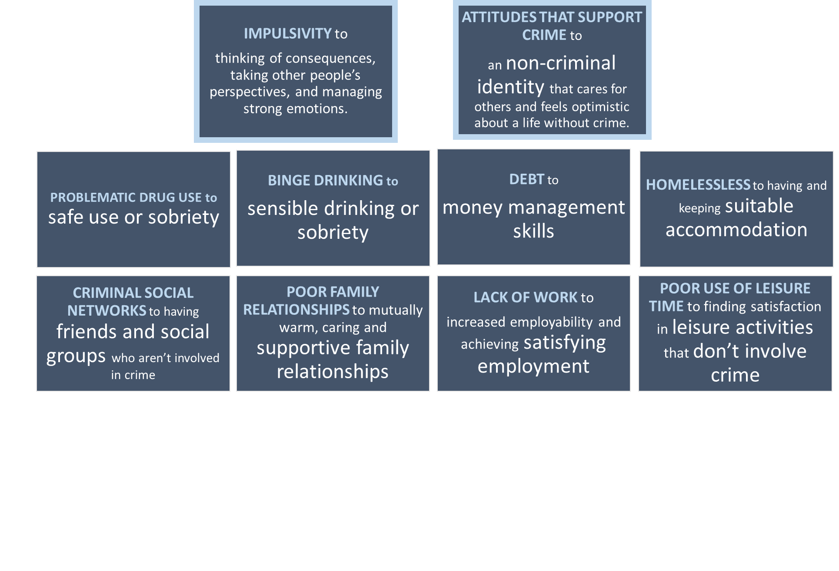
We can increase public safety (and reduce reoffending by) enabling people to move from….

Slide 12
Building Strengths and Hope
• Letting people know you believe in them
• Encouraging people
• Managing people’s mistakes discreetly
• Modelling a helpful approach
• Getting people involved and taking responsibility
• Helping people develop skills and confidence so they feel empowered
• Facilitating people in supporting each other and sharing experiences
• Helping people develop realistic goals

Slide 13
Thank you for listening

